Slide 1

RISK AND RESILIENCE BOOTCAMP
5

Slide 2


Slide 3

Risk Tolerance and ROI
This module introduces and explores
  The process of estimating risk tolerance for an organization
  Formal risk frameworks
  Cost benefit analysis of risk mitigation

Slide 4
Decision-Making Frameworks
Effective security and risk management
  Requires structured decision-making approaches that ensure consistency, transparency, and alignment with organizational objectives
  Decision-making frameworks provide a systematic process for identifying risks, evaluating options, and determining the most appropriate course of action
Common frameworks used for risk management
  NIST Risk Management Framework (RMF)
    Provides a life-cycle process that includes categorization, control selection, implementation, assessment, authorization, and continuous monitoring
    Helps organizations match security controls to mission impact and risk tolerance

Slide 5
Decision-Making Frameworks
Common frameworks used for risk management
  ISO 31000 Risk Management Principles
    Offers a high-level structure for identifying, analyzing, evaluating, and treating risks.
    Ensures risk activities are consistent with enterprise strategy
  OCTAVE and FAIR Frameworks
    OCTAVE focuses on organizational knowledge to evaluate risk scenarios.
    FAIR quantifies risk using financial impact, probability, and loss frequency, supporting more precise decision making

Slide 6
Decision-Making Frameworks
Provide the structure, language, and processes organizations use to define, measure, and align risk appetite and risk tolerance
  Frameworks do not set the appetite or tolerance themselves
  But they influence the way organizations understand, quantify, and justify them
Why they are used
  Standardized definitions create organizational alignment
  Different departments often interpret "acceptable risk" differently
  Formal frameworks:
    Provide standard terminology (e.g., likelihood, impact, inherent risk, residual risk)
    Enforce common measurement criteria (qualitative scales, quantitative metrics)
    Require consistent categorization and rating of risks

Slide 7
Decision-Making Frameworks
Impact on risk appetite and tolerance
  Reduces ambiguity about what is acceptable or unacceptable risk
  Aligns risk decisions across business units
  Prevents operational teams from being too risk-averse or too risk-seeking
  Anchor appetite and tolerance to business objectives
  Standards emphasize linking risk decisions to strategic objectives
  This means organizations must:
    Identify business goals
    Map risks to those goals
    Determine how much risk exposure is acceptable in pursuit of those goals
  Risk appetite becomes strategy-driven, not fear-driven or convenience-driven

Slide 8
Decision-Making Frameworks
Governance structures enforce consistency
  Formal frameworks require:
    Governance committees
    Documented policies
    Defined approval thresholds
    Oversight mechanisms
    Roles and responsibilities for risk owners
  Governance formalizes:
    Who sets risk appetite (typically the Board or senior leadership)
    Who sets tolerance levels (often operational leaders and risk committees)
    How deviations are escalated and managed
    This prevents arbitrary or inconsistent risk-taking across the organization.

Slide 9
Decision-Making Frameworks
Metrics and quantification
  Frameworks such as FAIR and NIST’s risk scoring models introduce quantitative elements:
    Probabilistic risk estimates
    Financial impact modeling
    Loss expectancy calculations
    Threshold-based risk scoring
  Risk appetite and tolerance shift from vague concepts to measurable parameters
    “We accept risks up to $2M in potential annualized loss.”
    “We tolerate system downtime of up to 4 hours per quarter.”
    “We will not accept a risk with a likelihood score > 3 unless mitigations are in place.”

Slide 10
Decision-Making Frameworks
Map controls to risk levels
  NIST RMF and ISO-based control catalogs provide baseline controls based on system criticality or risk categories
  Appetite and tolerance become operationalized
    High-impact systems require strong controls require low tolerance
    Moderate-impact systems have flexible controls require moderate tolerance
    Low-impact systems rely on minimal controls require higher tolerance
  Instead of subjective decisions, organizations apply consistent control strength based on a risk framework

Slide 11
Decision-Making Frameworks
Documentation and audits
  Formal risk frameworks require thorough documentation
    Risk registers
    Treatment plans
    Residual risk acceptance forms
    Justifications for mitigation vs. acceptance
    Continuous monitoring reports
  The act of documenting risk decisions forces
    Explicit justification of tolerance levels
    Evidence-based reasoning for risk acceptance
    Leadership visibility into risk posture
    This helps prevent unnoticed “shadow risks” growing outside of governance.

Slide 12
Decision-Making Frameworks
Continuous monitoring
  Frameworks embed continuous monitoring and periodic reassessments
    Regular reviews of appetite statements
    Updated risk evaluations
    New threat intelligence
    Post-incident reviews that feed into governance
  Risk appetite and tolerance become dynamic, not static
  Organizations adjust tolerance levels based on
    Changing business priorities
    New regulations
    Shifts in threat landscape
    Post-incident lessons learned
    Emerging technology adoption
  This ensures the organization isn’t locked into outdated risk assumptions

Slide 13
Decision-Making Frameworks
Formal escalation paths
  Frameworks define escalation thresholds tied to tolerance boundaries.
  Example
    If risk exposure exceeds tolerance, then escalate to risk committee
    If residual risk exceeds appetite, then escalate to executive leadership
    If risk exceeds Board-defined appetite, then mitigation becomes mandatory
  Prevents
    Operational teams from silently accepting high levels of risk
    “Risk creep” where tolerance increases unintentionally
    Leaders from being unaware of critical risks
    This reinforces governance discipline

Slide 14
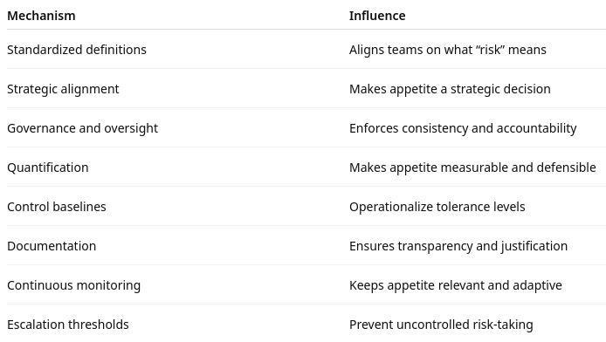
Frameworks Shape Appetite/Tolerance

Slide 15
Risk/Reward Trade-Off Analysis
Every security control or mitigation decision
  Requires understanding the trade-off between the risk being reduced and the reward being gained
  Key considerations
    Value of the asset being protected (financial, strategic, reputational)
    Likelihood and impact of the threat event if a control is not implemented
    Operational constraints, such as performance or user experience
    Costs and potential organizational gains from mitigating or accepting the risk
  Example
    Implementing multi-factor authentication (MFA):
    Reward: Substantial reduction in account takeover risk
    Risk/Cost: Increased user friction, potential helpdesk load
    Decision: Often justified for high-value systems or regulatory environments
  Analysis ensures that security decisions are balanced, avoid unnecessary controls, and align with business priorities.

Slide 16
CBA for Control Selection
A cost-benefit analysis (CBA) compares
  The cost of implementing and maintaining a control
  Against the value of the risk reduction it provides
  Helps justify investments and ensures resources are used efficiently
Components of a CBA
  Control costs
    Acquisition (software, hardware)
    Implementation (labor, integration)
    Maintenance (licensing, monitoring)
    Training and support

Slide 17
CBA for Control Selection
Components of a CBA
  Expected benefits
    Reduction in likelihood or impact of incidents
    Avoidance of financial loss or regulatory penalties
    Protection of brand reputation and customer trust
  Residual risk
    Risk remaining after the control is applied
  A well-performed CBA
    Supports evidence-based decisions
    Helps security leaders choose controls that deliver the highest return on risk reduction

Slide 18
Risk-Adjusted Decision Making
Integrates quantitative and qualitative risk assessments into day-to-day and strategic choices
  Shifts decisions from opinion-driven to data-informed, aligning them with organizational risk appetite
Elements of risk-adjusted decisions
  Risk quantification: Estimating probability, impact, and exposure
  Scenario-based analysis: Evaluating multiple future conditions
  Prioritization models: Ranking risks by severity and business value
  Opportunity cost evaluation: Understanding what is sacrificed by choosing one option over another

Slide 19
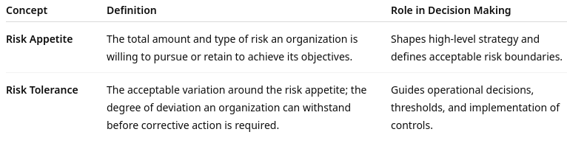
Risk-Adjusted Decision Making
Benefits
  Ensures consistency in decisions across departments
  Aligns security investments with business priorities
  Supports better resource allocation
  Enhances transparency and reduces bias in decision-making processes

Slide 20
Impact on Risk
Risk appetite and tolerance influence decisions in multiple ways:
  Accepting risk
    Organizations with a higher appetite may accept risks to enable innovation, speed, or market advantage
    Often seen in startups, product-development teams, and organizations in competitive markets
  Mitigating or transferring risk
    Organizations with low tolerance may implement stringent controls, adopt insurance, or outsource high-risk functions
    Common in regulated sectors such as banking, healthcare, and government
  Escalation and decision thresholds
    Clearly defined tolerance levels dictate when risks must be escalated to leadership.
    Ensures consistent risk handling across teams, reducing subjectivity.
  Strategic alignment
    Aligning security controls with risk appetite prevents over-engineering and under-protection.
    Promotes efficient resource allocation and prioritization of high-impact risks.

Slide 21

Q&A and open discussion
Notes:
Now is the time to engage in an interactive Q&A session where you can ask questions, share insights, and clarify any doubts about the topics we have covered so far.
This open discussion is designed to ensure that every participant has the opportunity to voice their thoughts and learn from the collective experience of the group.
Your questions and comments are valuable as they help us identify areas that may need further explanation and enable us to tailor future sessions to your needs.
We encourage you to speak up and contribute to the dialogue, as this interaction is one of the key components of our interactive learning approach.
As the session progresses, take note of any questions or ideas that you would like to revisit, and feel free to share your perspectives with the class.

